Slide 1
TRANSPORT MANAGEMENT
Notes:
Introductie docent en student (achtergrond, waar vandaan etc)

Slide 2
Course goals Transport Management
The main goal of this course is being able to apply and interpret the concept of transportation within supply chains. Secondly, the goal is to gain more insight in transport cost organizations, utilization and its business positioning.
This course contains the following aspects:
demand of transport;
Specification of goods;
basic knowledge of transport modes;
choice of transport modes;
relationship between transport and supply chains;
basic knowledge of transport organizations and its business positioning.

Slide 3
Why Transport?
Transport activities because of economic activities
Transport is caused by a division (in space and time) of the
points of production and consumption
Notes:
Vertel over Nederland als distributieland
NL wil zich profileren…onderzoek, kennis nodig mbt transport

Slide 4

Parties in Transport
Sender
Flow of goods
Receiver
Demand side
Delivery conditions
Transport modalities
Means of transport
Own and professional transport
Routing
Insurance risks
Groupage and consolidation
Scheduled and irregular transport
Documents and waybills
Transport costs/ rates
BUYING
Agent
Carrier
Means of transport
Logistic services provider
Supply side
Shipping agent
Groupage agent
Consolidator
Stevedore
Container terminal
Ground handling
Ship broker terminals
Transport modes
Means of transport
Transport networks
Personnel]
Cost price margin
Infrastructure/
‘roads’
Government
Roads
Railway
Harbour, inland port
Pipelines
Intermodal terminals
Important parties in transport of goods

Slide 5
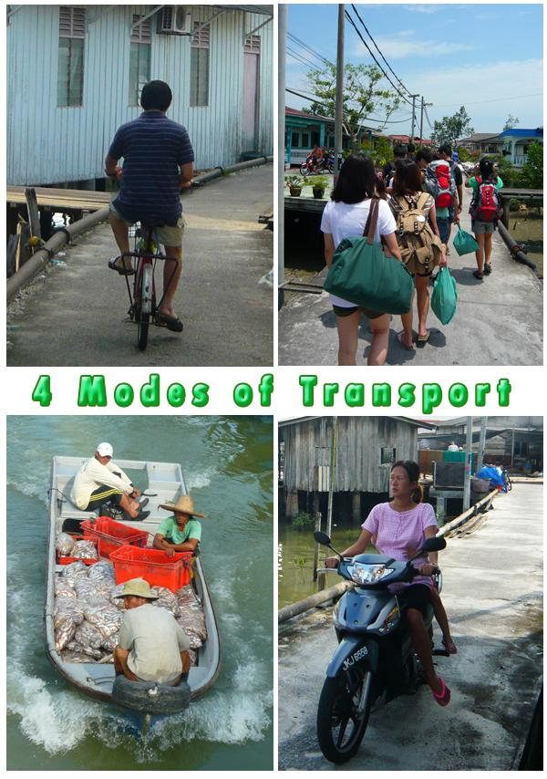
Modes of Transport
Road transport
Inland waterways
Railway transport
Pipeline transport
Sea transport
Shortsea
Deepsea
Air transport
Notes:
Costs per ton – km for a means of transport
Plane: 334 euro per km
Truck: 100 euro per km
Train: 23 euro per km
Pipeline: 9 euro per km
Ship : 7 euro per km

Slide 6
Logistic Framework
Logistic framework (Pag.51 study book Logistics: Principles and Practice

Slide 7
Trends in Transport
Efficiency of road transport tumbles down….;
Crisis has consequences for occupation degrees;
Transit time decreases……
Price of transport increases or decreases?
Sustainability will become a part of an offer;
Reduction of emissions :
SO2 Sulphur dioxide Dutch: Zwaveldioxide
CO2 Carbon Dutch: Koolstof dioxide
Nox Nitrogen oxygen Dutch: Stikstofoxide
PM10 Fine dust Dutch: Fijnstof
Notes:
In 2007 +1 % rentabiliteitstijding
Internationaal georienteerde bedrijven in 2007 -1,2%
Mede door fors gestegen brandstofkosten
Vb 50% minder containers momenteel uit China. Inventeringen nemen af.

Slide 8
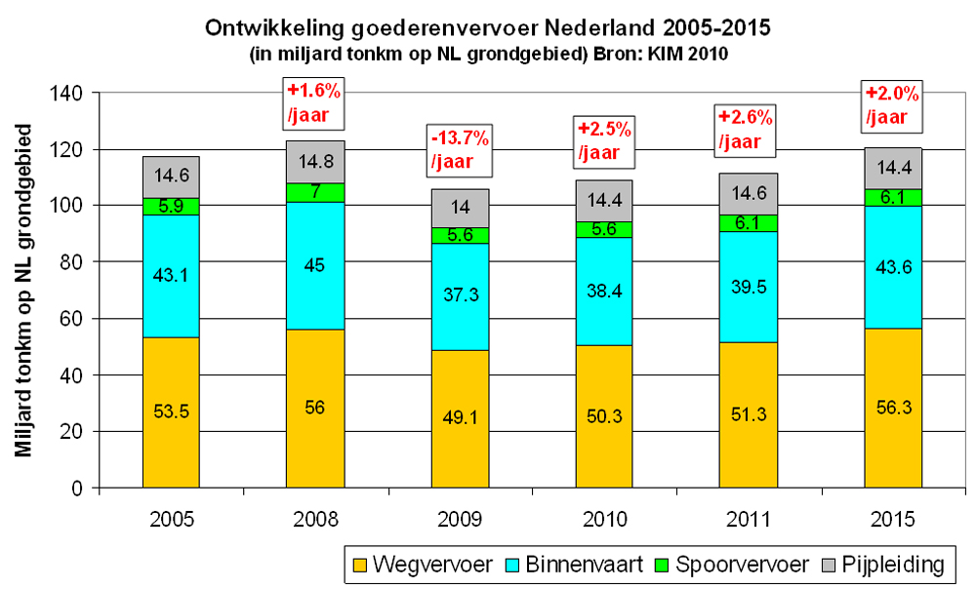
Development freighttransport Holland 2005 – 2015
(in billion tonkms on NL surface (KIM 2010)
+1,6%
/year
+2,0%
/year
+2,6%
/year
-/-13,7%
/year
+2,5%
/year
Billions ton/kms on NL surface
Pipeline
Road transport
Barge
Railtransport

Slide 9
Reasons and Methods for Transport
Causes
Methods/
Modes of transport
Demand side: shippers
Supply side: carriers
Trade
Industry
Buying
Production
Selling
Distribution
Consumption
(domestic/ import/
export/ transit)
Road transport
Inland shipping
Rail
Sea
Air
Pipeline
(Intermodal)
Transport
Goods
Means of transport
Reasons and methods for transport
Notes:
What choice depends on:
Speed
Accessiblity
Variability
Practibilityfrequency
Risk
Costs
(see study book pag 321)

Slide 10
What is Logistics?
Definition of logistics :
Logistics is the organization, planning, steering and execution of
the freight flow from development and purchase via production
and distribution to the consumer, including reverse logistics.
The goal is to fulfill the needs of the customer against low costs
and to create a long life relationship with the customer.
(Visser, Van Goor, p.21)

Slide 11
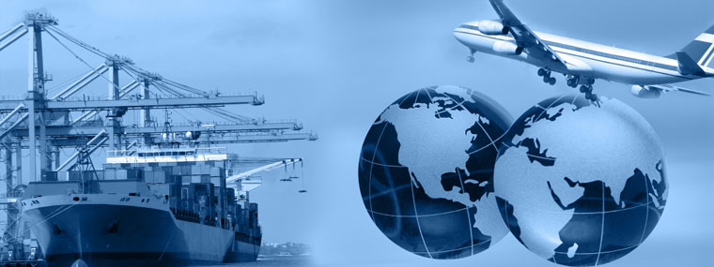
What is logistics?
Bringing the right goods…
on the right time…
on the right spot…
with the right quantity…
against optimal costs.
2. The study of efficient and effective planning of the whole supply.
3. It is a combination of organization – planning – steering and
execution of flows of money / goods / people / information/ energy…
……..from the development and purchasing, through manufacturing
and distribution to the customer (end user), up to and including the
reverse logistics flow. The aim is to meet market demand at lowest
costs and best use of capital, and building long-term relationships
with customers.

Slide 12
Logistic Framework
Logistic framework (Pag.51 study book Logistics: Principles and Practice

Slide 13
Logistic structure
Construction logistic framework :
Three primairy changing elements:
Stabilisation, Translation & Transformation
Stabilisation: Changing process in time
Translation: Changing process in place
Transformation: Changing process in characteristics

Slide 14
Supply chain definition 1
Supply chain management means literally: :
Control of the supply chain . Supply chain management arranges the supply of the merchandise
to a certain point, for example in a factory. With everything around
it like operational management, order processes, keep up the stock
at the suppliers and the consumers, IT, licences, human resource
needs, finance, planning, etcetera.

Slide 15
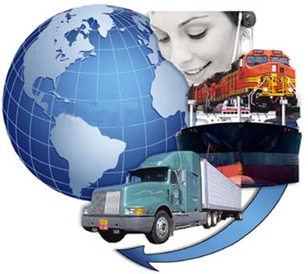
What is a Supply Chain?
Company A
Company B
Company C
Examples of Supply Chains

Slide 16
Transport within Supply Chains
Transport within supply chains
SUPPLIERS
(e.g. raw materials, materials, packaging, services)
Transport
FACTORY/ PRODUCTION
(Final products)
Transport
DISTRIBUTION CENTRE PRODUCER
World/ international
European
Per country
Regional
Transport
IMPORTER
(In case of foreign manufacturer)
Transport
WHOLESALER
Distribution centre
Transport
RETAIL TRADE/ RETAILER/ DEALER
Distribution centre
Sales branches
Transport
END-USER/ CUSTOMER/ CONSUMER
Notes:
Primair transport: van fabrikant naar het distributiecentrum
Secundair transport: van het distributiecentrum naar groothandel en importeur
Tertiair transport: van groothandel en importeur naar de detailhandel/ dealer/ wederverkoper

